Slide 1
Peregrine
Nathan Justice
DATS 6501 - Capstone

Slide 2
Problem Statement
Automatic dependent surveillance-broadcast (ADS-B), the burgeoning technology used to track and monitor airspace travel across the world, is a bountiful source of data broadcast over the air. Despite the abundance and accessibility, ADS-B data are often messy, incomplete, and difficult to use in their raw form. By implementing fixes to the data quality, useful tools can be developed to facilitate analysts' investigation into projects involving aircraft and airspace travel.

Slide 3


Disclosure
This project is done in collaboration with the Center for Advanced Defense (C4ADS), under the direction and supervision of Data Machines Corp. (DMC), as part of a paid internship.

Slide 4
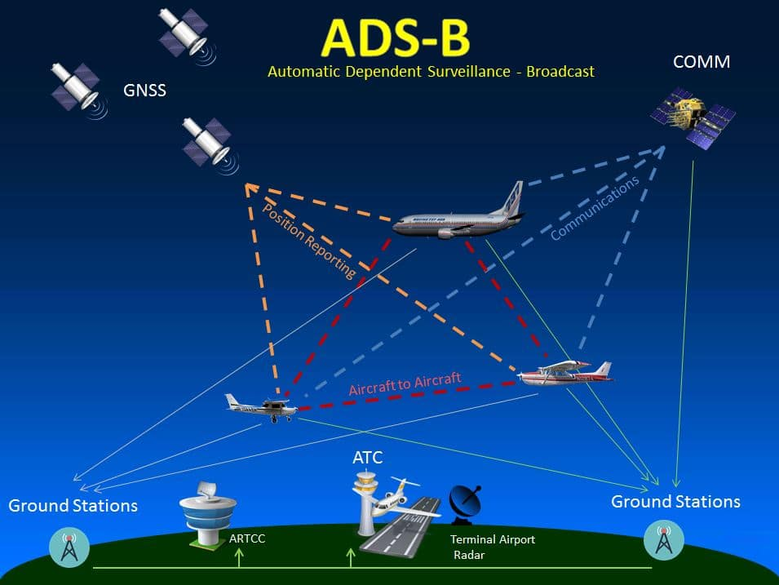
ADS-B

Slide 5
Problem Elaboration
C4ADS is a "nonprofit organization dedicated to providing data-driven analysis and evidence-based reporting on global conflict and transnational security issues".
team of investigative analysts
research area: organized crime and nefarious actors
partnership with ADS-B Exchange
major prior success, but arduous work
unfiltered and unedited streams missing key features

Slide 6
Problem Elaboration cont
Project Goals:
improve the quality of the existing ADS-B data and engineer new features woefully lacking in its current form
develop an application informed by user-stories that will facilitate the way C4ADS analysts utilize ADS-B data
(stretch) implement features that allow client-specific questions to be investigated

Slide 7
References
Tesi, S., & Pleninger, S. (2017). Analysis of Quality Indicators in ADS-B Messages. MAD-Magazine of Aviation Development, 5(3), 6-12.
Syd Ali, B., Schuster, W., Ochieng, W. et al. Analysis of anomalies in ADS-B and its GPS data. GPS Solut (2016) 20: 429.
https://static1.squarespace.com/static/566ef8b4d8af107232d5358a/t/5b8847a8c2241b8686fcd05a/1535657953438/In+Plane+Sight.pdf

